Slide 1
Proton Plan
Cost and Schedule Report
Jeff Sims

Slide 2
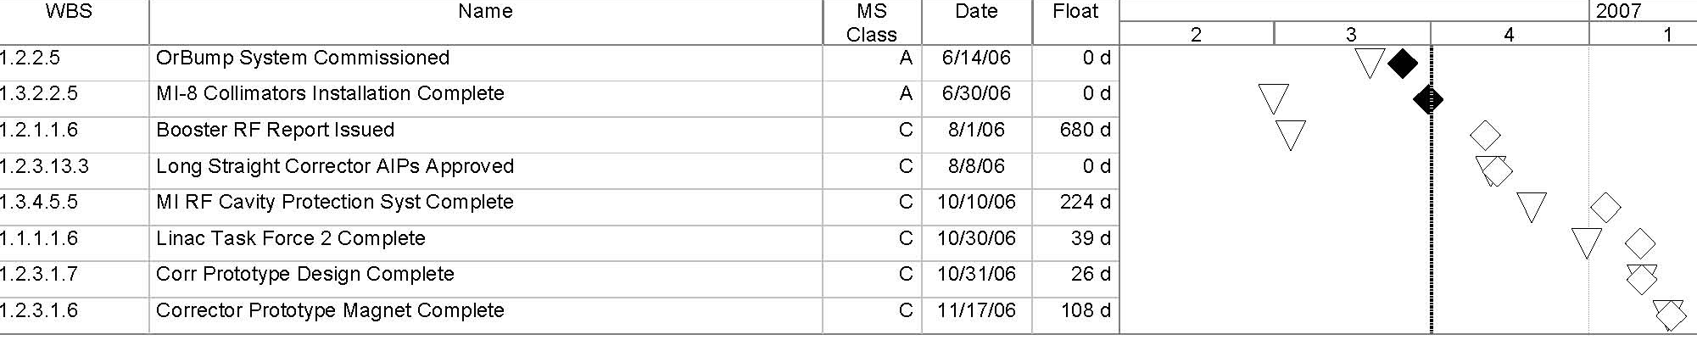
Milestones to End of 2006
Legend
Forecast Date –
Complete Date-
Baseline Date -

Slide 3
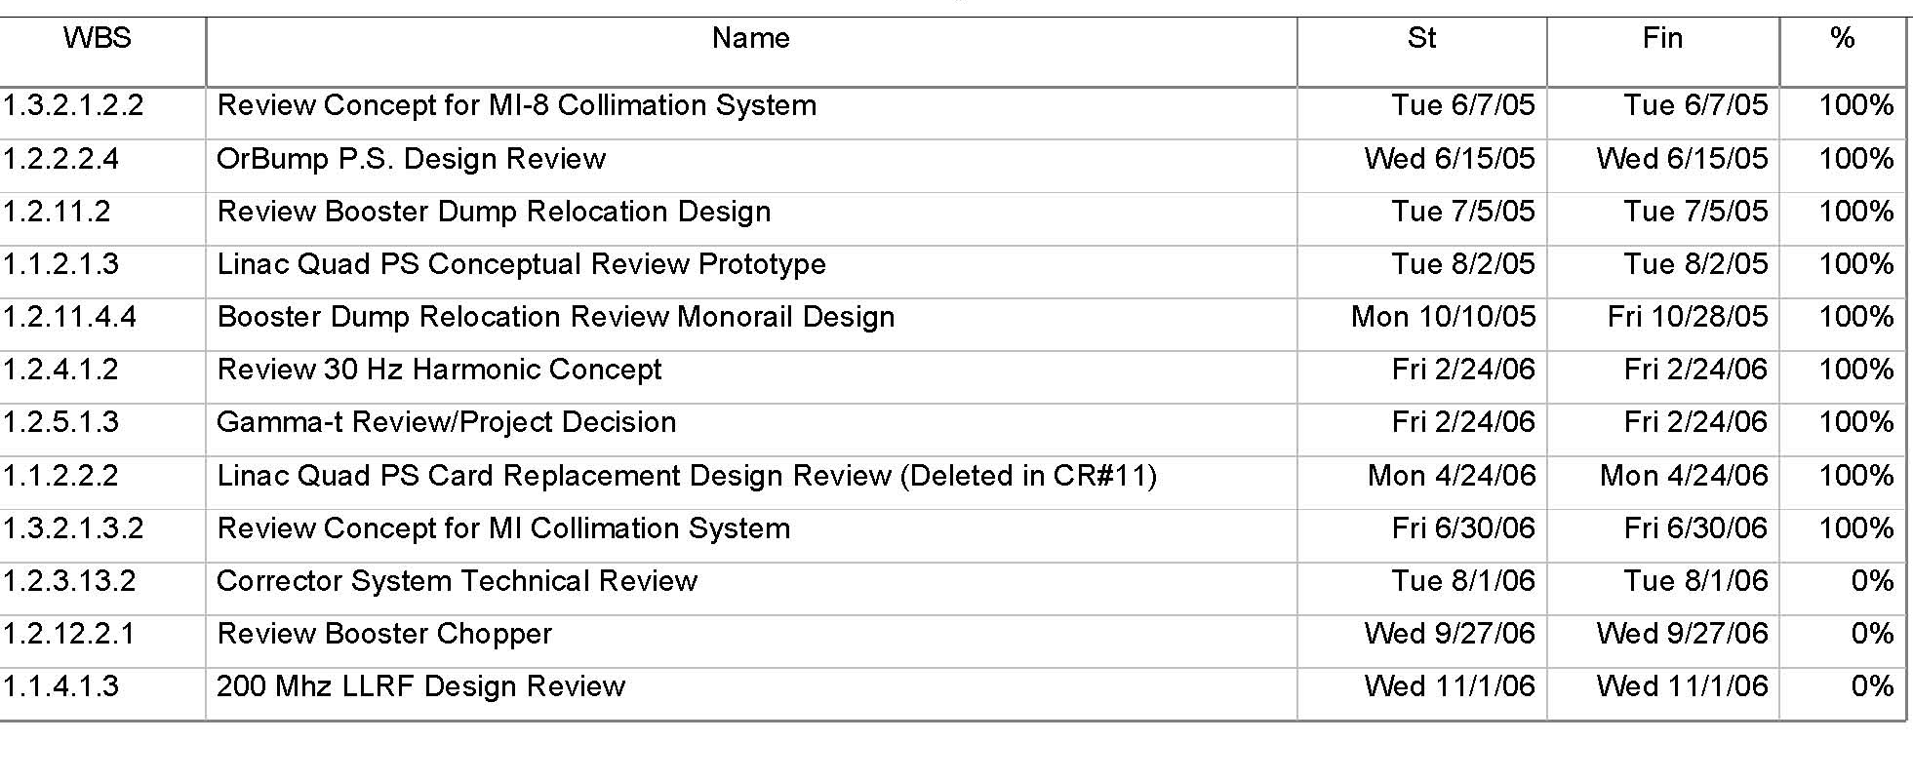
Project Reviews
Planning
Director’s Review – August 15, 16 2006

Slide 4
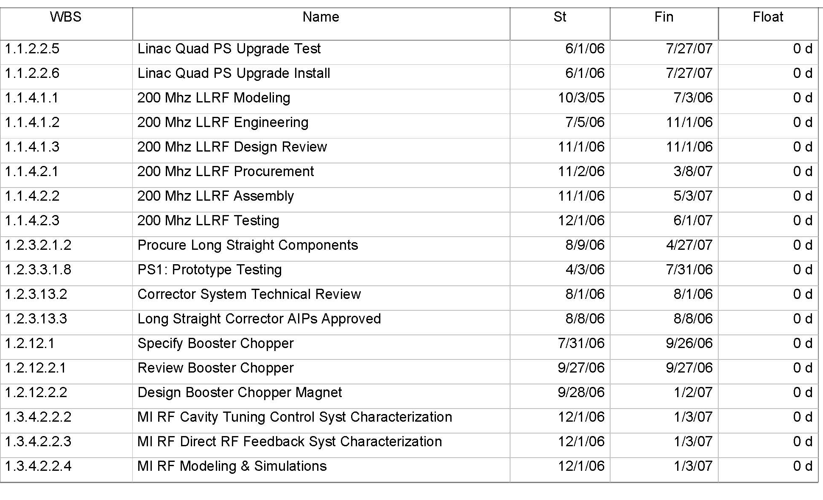
Critical Path Analysis to the end of 2006

Slide 5
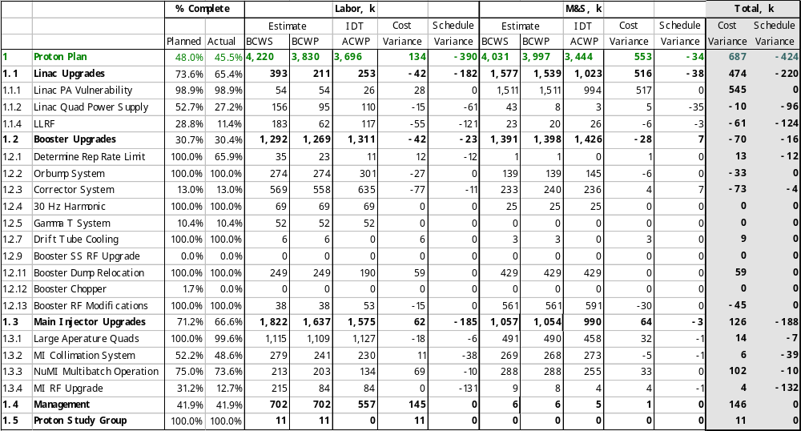
Earned Value
Thales Prototype Facility Descoped
Descoped
Off Project

Slide 6
EV Analysis
M&S Cost and Schedule Variance.
  1.1.1 – Linac PA vulnerability (+517k CV)
    3 Proton Plan Spares were sold to Proton Source as operational tubes. This $ may be needed to procure operational spares.
Labor Cost and Schedule Variance.
  1.1.2 – Linac Quad Power Supplies (-61k SV)
    Design efforts suffered from shutdown activities. We hope to get back on track over the next few months.
  1.1.4 – Linac Low Level RF (-121k SV)
    Modeling and design efforts suffered from shutdown activities. We hope to get back on track over the next few months.
  1.2.3 – Booster Correctors (-77k CV)
    We may have underestimated the average hourly rate of the TD technicians doing the Prototype work. We are working with TD to understand if we need to revise the Tech SWF for the Correctors prototype effort.
  1.3.4 – MI RF Upgrades (-131 SV)
    Lack of adequate RF resources over the last 3 months have caused this task to slip. Now that the shutdown is over RF resources have been assigned and are moving forward on this work.

Slide 7
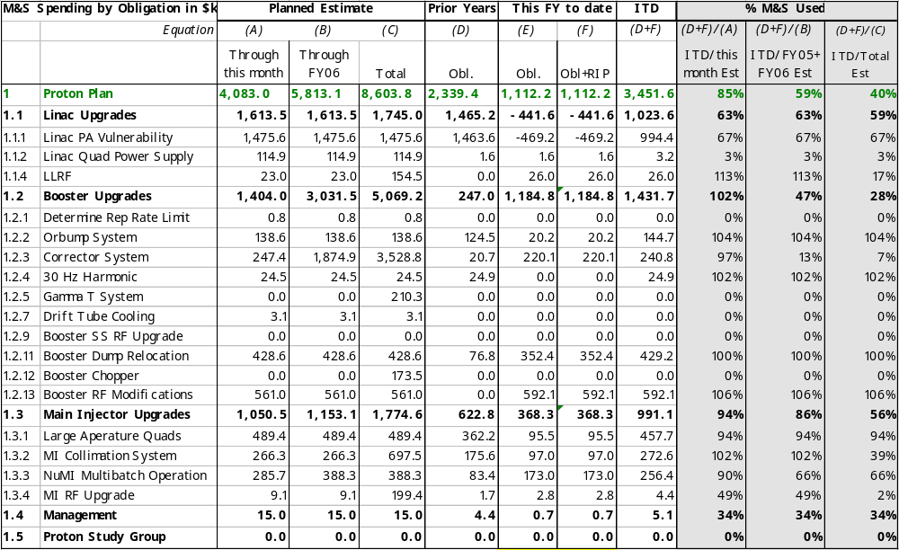
M&S Cost Performance

Slide 8
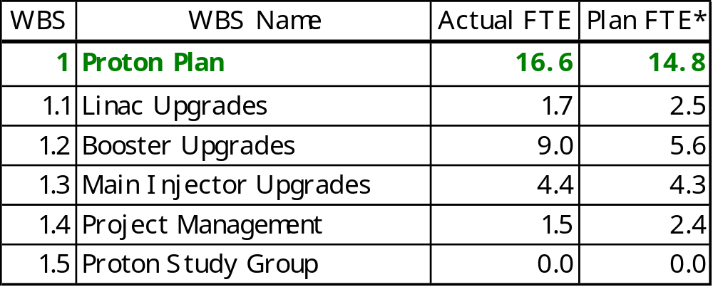
Effort for June ‘06
1
Variance Notes:
*Based on June 2006 Status Update
Booster Correctors Prototype – A substantial increase in effort on Booster Correctors Prototype occurred in May and June.

Slide 9
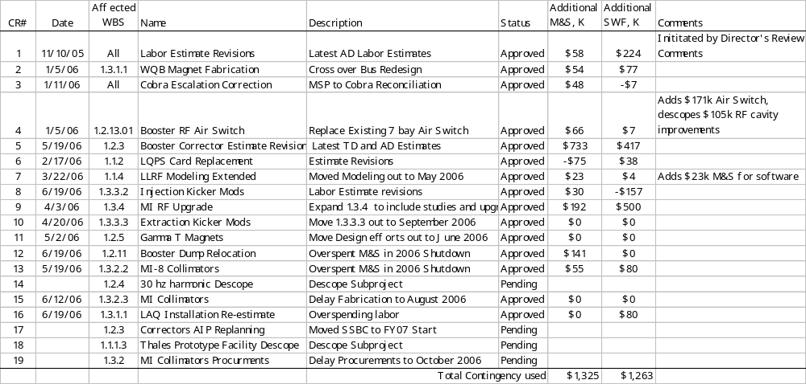
Change Request Log
Ready for Signature
Ready for Signature
Ready for Signature
Ready for Signature

Slide 10
Pending Changes 1 of 2
CR-14: 30 hz Harmonic Descope (Ready for Signature)
  Scope: Descope Subproject
    SWF Increase = -$448k
    M& S Increase = -$1,083k
    Schedule Impact = No Class A MS impacted
CR-17: Corrector System AIP Replan (Ready for Signature)
  Scope: Move SS BC out to FY07 Start
    SWF Increase = $14k
    M& S Increase = $11k
    Schedule Impact = No Class A MS impacted
CR-18: Thales Prototype Facility Descope (Ready for Signature)
  Scope: Descope Subproject
    SWF Increase = -$521k
    M& S Increase = -$1,577k
    Schedule Impact = No Class A MS impacted

Slide 11
Pending Changes 2 of 2
CR-19: MI Collimators Procurements (Ready for Signature)
  Scope: Move Procurements out to October 2006
    SWF Increase = $0k
    M& S Increase = $10k
    Schedule Impact = No Class A MS impacted
This is all FY07 M&S $
Does not affect the current 2nd floor held contingency
Reduces Proton Plans FY07 M&S Budget needs by:
Base = $ 2640k
Contingency=$ 1558k
Total = $ 4198k*
*Planned to be AD M&O for Booster SS Replacement efforts in FY07

